Slide 1
Phonebook by Python
Isham Sinha
Shreya Mishra
Skanda Shreesha Prasad

Slide 2
What is a Phone?
A mobile phone/cell phone/telephone/hand phone/smartphone is a device which permits two users to communicate when they’re too far apart to hear each other
It was invented by Alexander Graham Bell and in 1876, he was granted a patent by the United States.
The instrument was rapidly picked up on and developed by others. It quickly became an indispensable part of households, businesses and governments.

Slide 3
Mobile Phones
A mobile phone, cellular phone, cell phone, cellphone, handphone, or hand phone, sometimes shortened to simply mobile, cell, or just phone, is a portable telephone that can make and receive calls over a radio frequency link while the user is moving within a telephone service area.
The first handheld mobile phone was demonstrated by John F. Mitchell and Martin Cooper of Motorola in New York City in 1973.
Released in 1983, the Motorola DynaTAC 8000x was the first commercial hand-held mobile phone.

Slide 4
Phonebook
A phonebook is a record containing a list of telephone subscribers in a geographical location.
It was used to allow the telephone number of a subscriber, usually in alphabetically order, identified by name or address.
The most commonly used phonebooks were the Yellow Pages for business and Telephone Directories and White Pages for the personal details.
The manufacture of internet and smartphones have greatly inhibited the use of a paper phonebook in recent times.

Slide 5
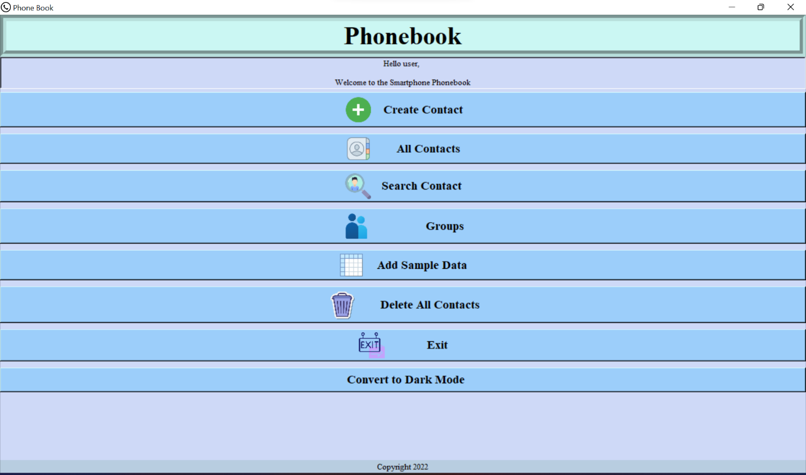
Phonebook Project - Light Mode

Slide 6
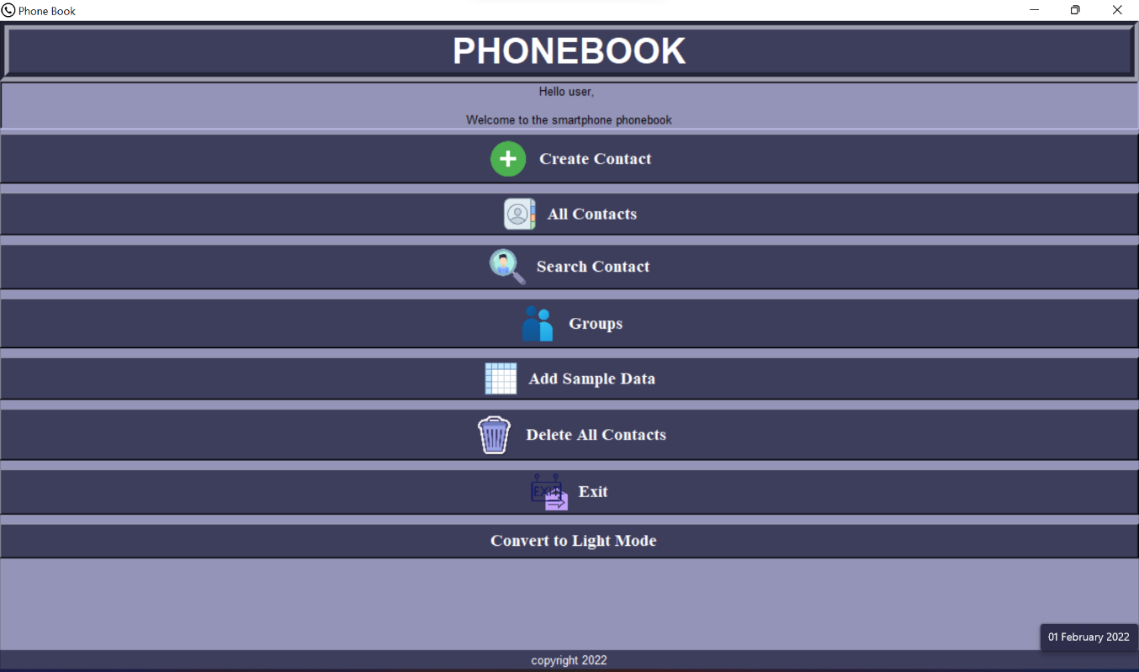
Phonebook Project – Dark Mode

Slide 7
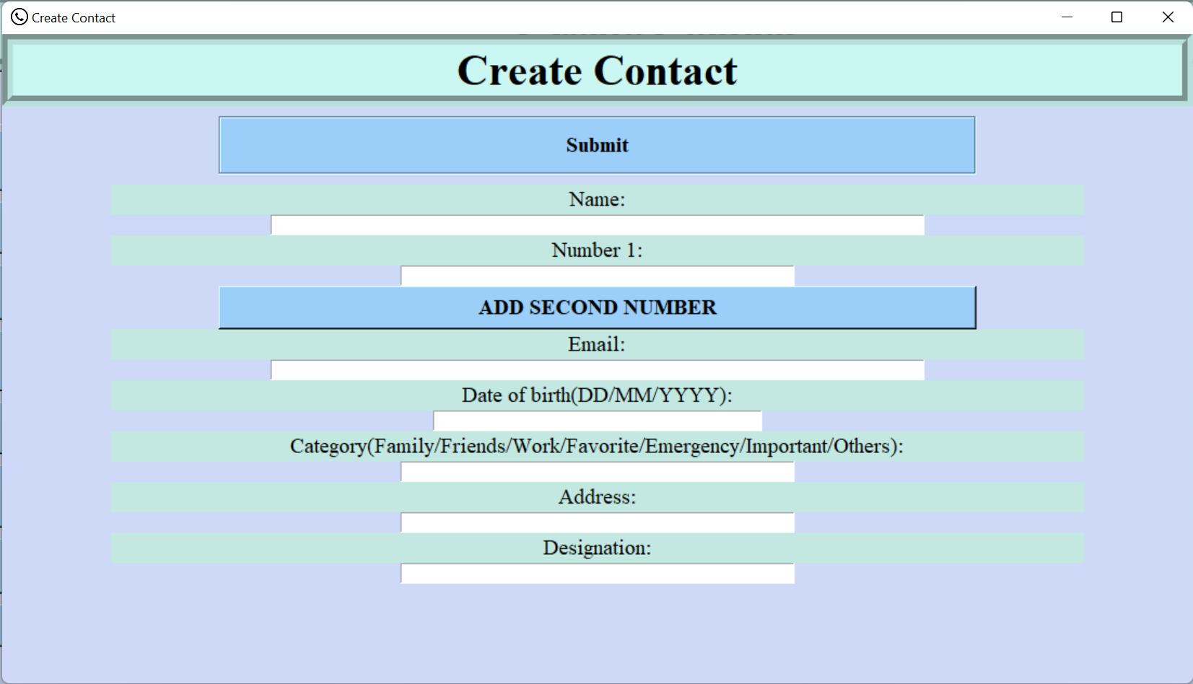
Phonebook Project - Create Contact Page

Slide 8
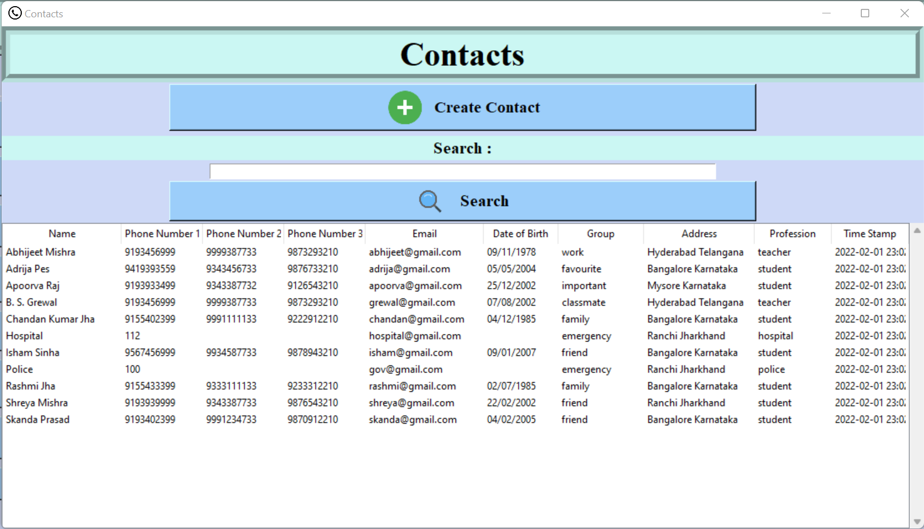
Phonebook Project - All Contacts

Slide 9
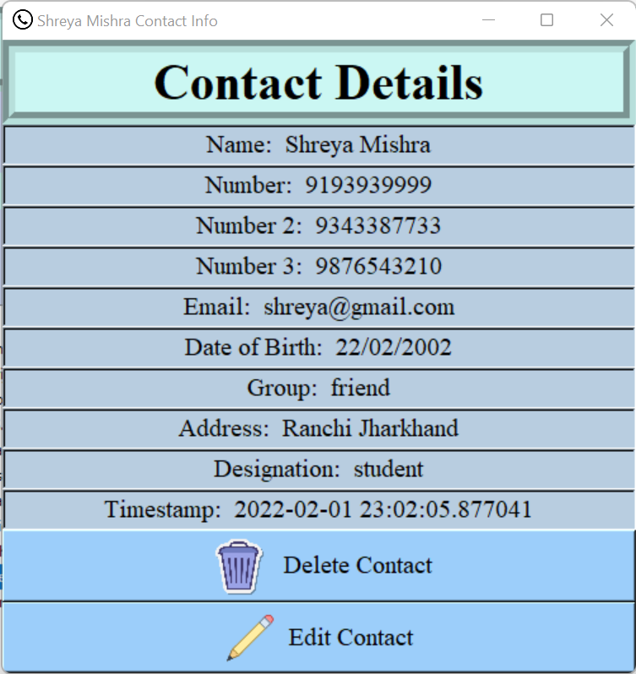
Phonebook Project – Contact Display

Slide 10
Conclusion
This project of preparing a phonebook using Python language has helped us understand the importance of functions and Graphical User Interface.
It also helped us understand the various modules used.
This application would greatly help the users to store important details about a person.

Slide 11
Questions?

Slide 12
Thank You!

